Slide 1
3
Bab
Keselamatan Konstruksi dan Permesinan
Disusun oleh Tim Dosen K3L FTUI
Genap 2019/2020

Slide 2
Pengantar
1-1
Risiko dalam suatu kegiatan konstruksi atau industrial perlu dikaji dalam sistem manajemen kesehatan dan keselamatan kerja untuk setiap tahapan dalam siklus hidup suatu proyek, plant atau teknologi.
[Hammurabi]
Referensi: dari berbagai sumber.

Slide 3
Keselamatan Konstruksi
Designing for Construction Safety is the process of of addressing construction site safety and maintenance in the design phase of a project.
The customary role of the design professional is protect the safety of the public and to comply with building codes.
Designing for Construction Safety extends this role to include construction site safety.

Slide 4
1. Recognized Hazards
Gravity-Falls from elevation
Falling objects
Slopes-Upset
Rollover
Unstable surfaces
Water- Drowning

Slide 5
Recognized Hazards
Walking/working surfaces-
tripping, slipping
Mechanical hazards-
Rotation, reciprocation, shearing,
vibration, pinch points, hydraulics,
pneumatics, entanglement

Slide 6
Recognized Hazards
Stored energy- springs, pneumatics
hydraulics, capacitors
Electrical-electrostatic, current, voltage, sparks, arcs
Chemical-corrosive, combustion, toxic

Slide 7
Recognized Hazards
Biological-allergens, carcinogens
Radiant Energy-sound, nuclear,
X-rays, light, lasers

Slide 8
Keselamatan dalam evolusi proyek konstruksi

Slide 10
Keselamatan dalam siklus hidup permesinan
1-1
Desain,
Pemilihan material,
Manufaktur,
Assembly,
Transportasi,
Commissioning,
Operasi dan Pemeliharaan
Demolition

Slide 11
Material Selection
Desain
Manufacturing
Demolition
Assembly
Operation & Maintenance
Transportation
Commissioning

Slide 12
Peran tahapan konstruksi pada aspek keselamatan
High
Conceptual Design
Detailed Engineering
Ability to Influence Safety
Procurement
Construction
Start-up
Low
Project Schedule
[Szymberski 1987]

Slide 13
Tingkatan (hierarchy) dalam pengendalian bahaya

Slide 14

Pengembangan konsep keselamatan konstruksi
Establish design for safety expectations
Include construction and operation perspective
Identify design for safety process and tools
Design Kickoff
Design
Internal Review
External Review
Issue for Construction
Trade contractor involvement
QA/QC
Cross-discipline review
Focused safety review
Owner review

Slide 15
Safety expectations are addressed in the beginning. There is trade contractor, QA, QC, owner, and contractor involvement throughout the design process. There are multiple reviews and re-designs. This all occurs before the drawings are finally issued for construction.
The key component of this process is the incorporation of site safety knowledge into design decisions. Ideally, site safety would be considered throughout the design process. It is recognized, however, that a limited number of progress reviews for safety may be more practical. The required site safety knowledge can be provided by one or more possible sources of such safety constructability expertise, including trade contractors, an in-house employee, or an outside consultant.

Slide 16
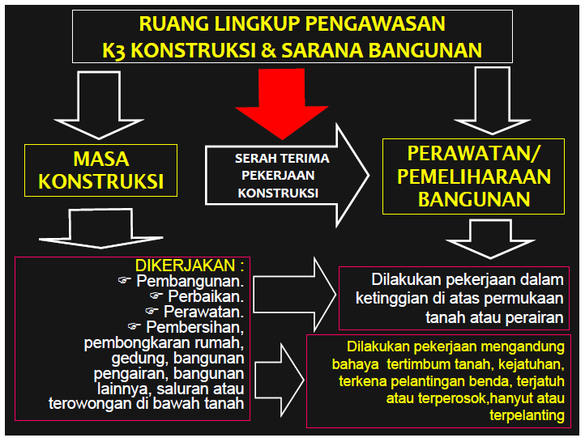

Slide 17
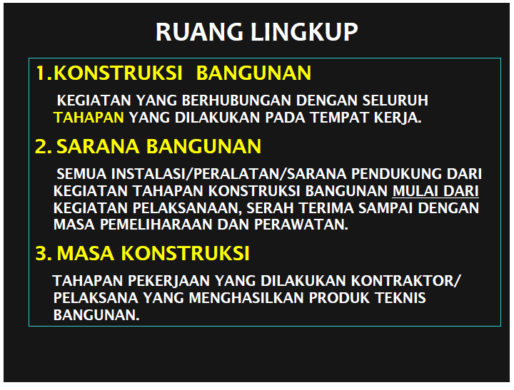

Slide 18
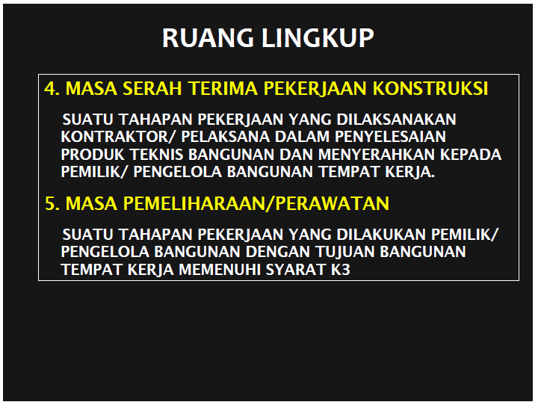

Slide 19
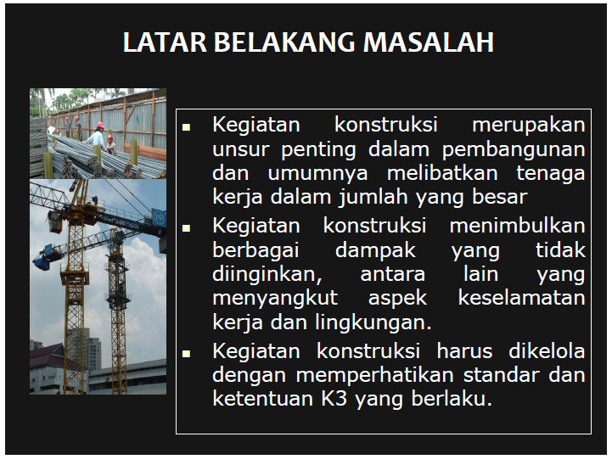

Slide 20
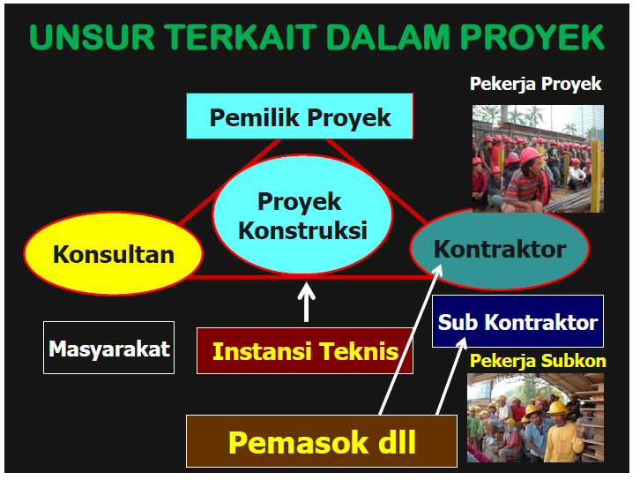

Slide 21
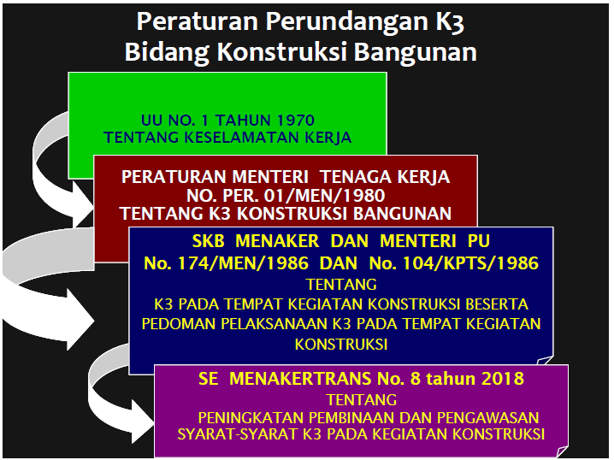

Slide 22
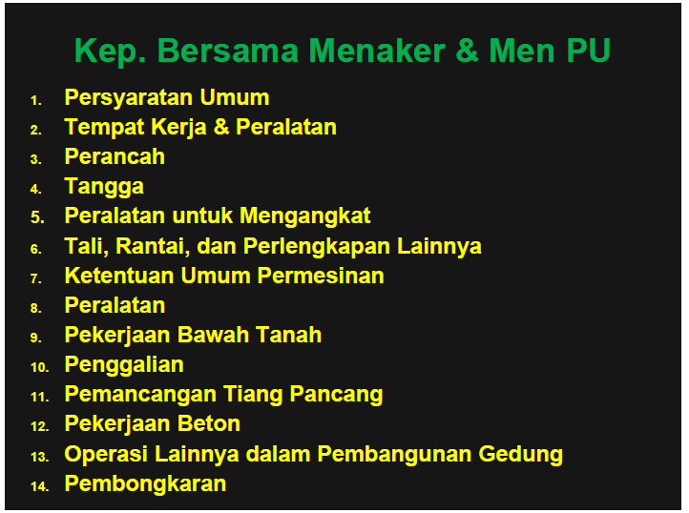

Slide 23
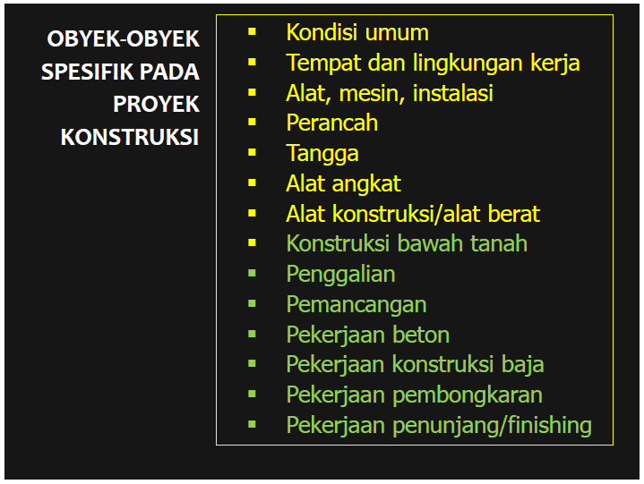

Slide 24
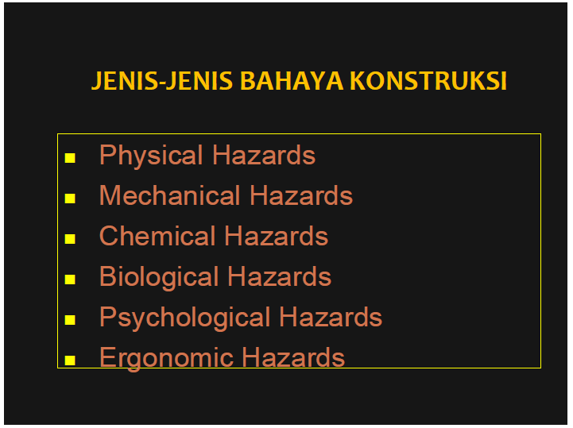

Slide 25
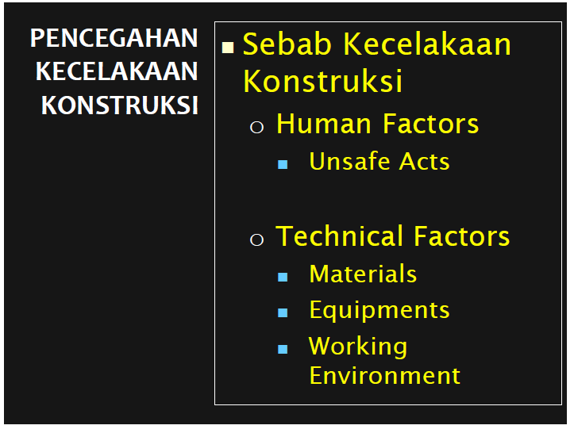

Slide 26
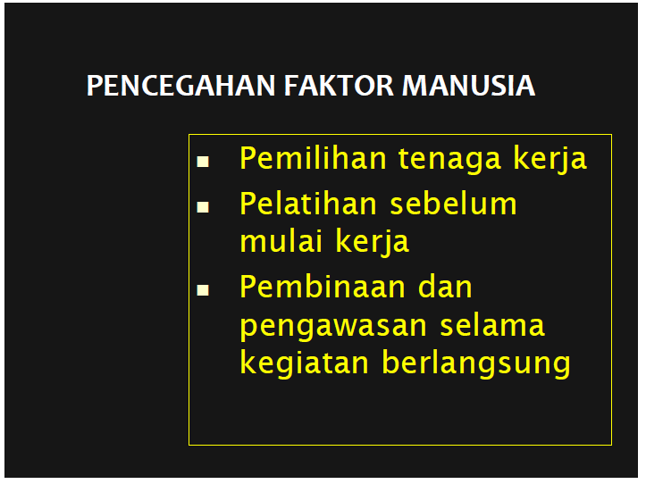

Slide 27
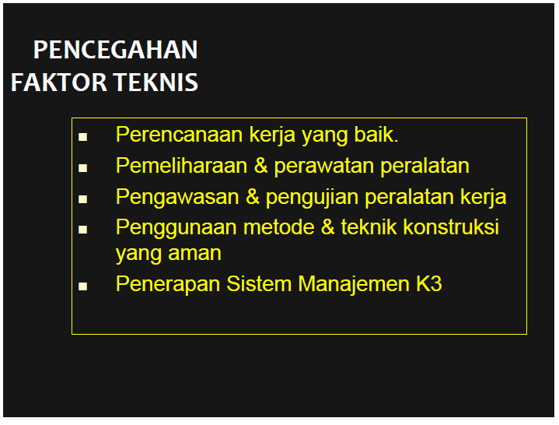

Slide 28
Pengendalian Risiko secara Teknis (Engineering Controls)
Secara teknis pengendalian keselamatan konstruksi, dapat dilakukan dengan memberikan perhatian khusus pada penggunaan peralatan / kegiatan:
Scaffolds
Fall Protection Anchorages
Hoists
Excavations
Shoring
Lift Slabs

Slide 29
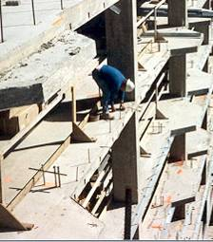
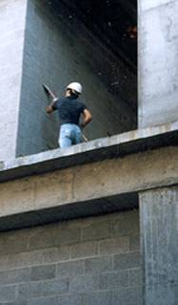
Recognized Hazards- Fall Hazards
Unprotected edges
¹Photos courtesy of Washington Group International
This is an example of a classic fall hazard. The worker is exposed to an unprotected edge. The designer could specify anchorage points in the design so that the worker will have a tie off for fall protection. It should be noted that Designing for Construction Safety is not how or when to use fall protection, it is designing buildings so that either fall protection is not needed, or, installed hardware such as tie-offs.

Slide 30
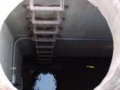
Recognized Hazards-Examples Confined Space
Confined spaces are another recognized hazard. Designer can be helpful by designing areas that do not require confined space entry procedures. It should be noted that Design for Construction Safety is how to implement a confined space entry procedure, it is how to design projects so that confined space entry is not required.

Slide 31
Hidden Hazards-Examples There are many hazards that may be hidden. They are not readily apparent to the worker or the designer.
Underground utilities
Electrical wire buried in a wall
Asbestos
Rot/Decay of structural members
Gas lines
Any hazard uncovered during project execution

Slide 32
Hidden Hazards-”What If” Analysis
A “What If” analysis is a structured brainstorming methods of uncovering hidden hazards
Select the boundaries of the review and assemble an experienced team
Gather information-video tapes of operation, design documents, maintenance procedures, etc.

Slide 33
Hidden Hazards-”What If” Analysis “What If” Situation Questions
In a “what if” analysis the design professional or design team needs to brainstorm things that can go wrong (“what if”).
Failure to follow procedures
Procedures are followed, but are incorrect
Equipment failure
Utility failure
Weather
Operator not trained

Slide 34
Kriteria pengaman permesinan yang ‘baik’ ✓

Slide 35
1= terbelit (entanglement)
2= gesekan dan abrasi
3= terpotong (cut)
4= tergunting (shear)
9 POTENSI
BAHAYA MEKANIS
5= tertusuk (stab/puncture)
6= tertumbuk (impact)
7= tergencet (crushing)
8= terjepit kedalam (drawing in)
9= terkena semburan udara bertekanan tinggi, fluida tekanan tinggi, ataupun semburan material padat lain

Slide 36
Ada 25 ancaman
bahaya bawaan (intrinsik)
dari peralatan mesin

Slide 37
ancaman
bahaya

Slide 38
ancaman
bahaya

Slide 39
ancaman
bahaya

Slide 40
ancaman
bahaya

Slide 41
ancaman
bahaya

Slide 42
ancaman
bahaya

Slide 43
ancaman
bahaya

Slide 44
Metode umum pengamanan peralatan mesin 

Slide 45
Tiga macam pengaman tetap yang umum
Total enclosure fixed guards
Limited access fixed guards
Adjustable access fixed guards

Slide 46
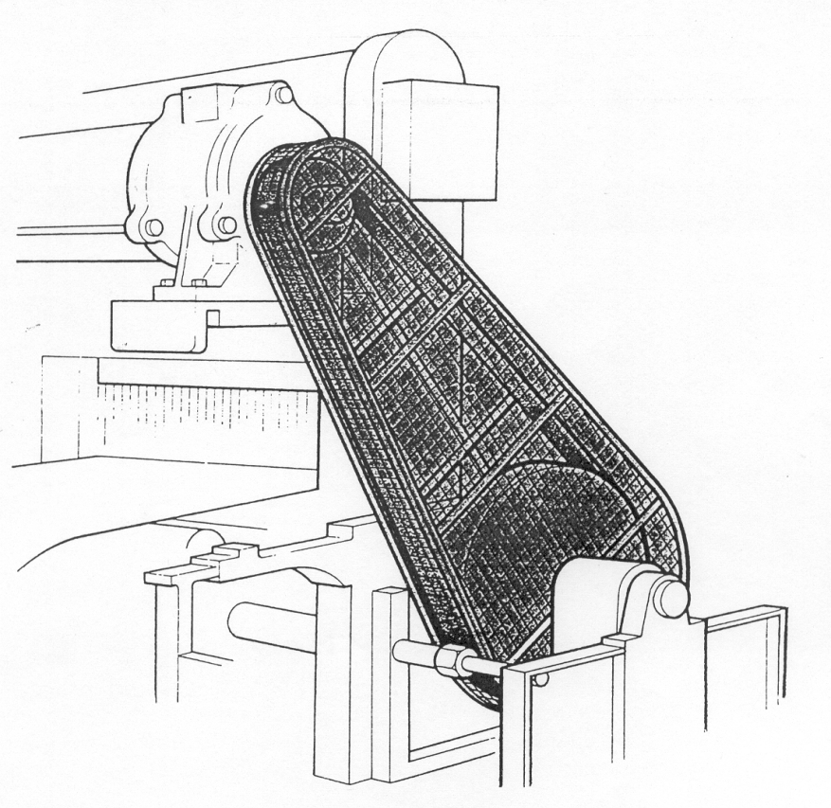
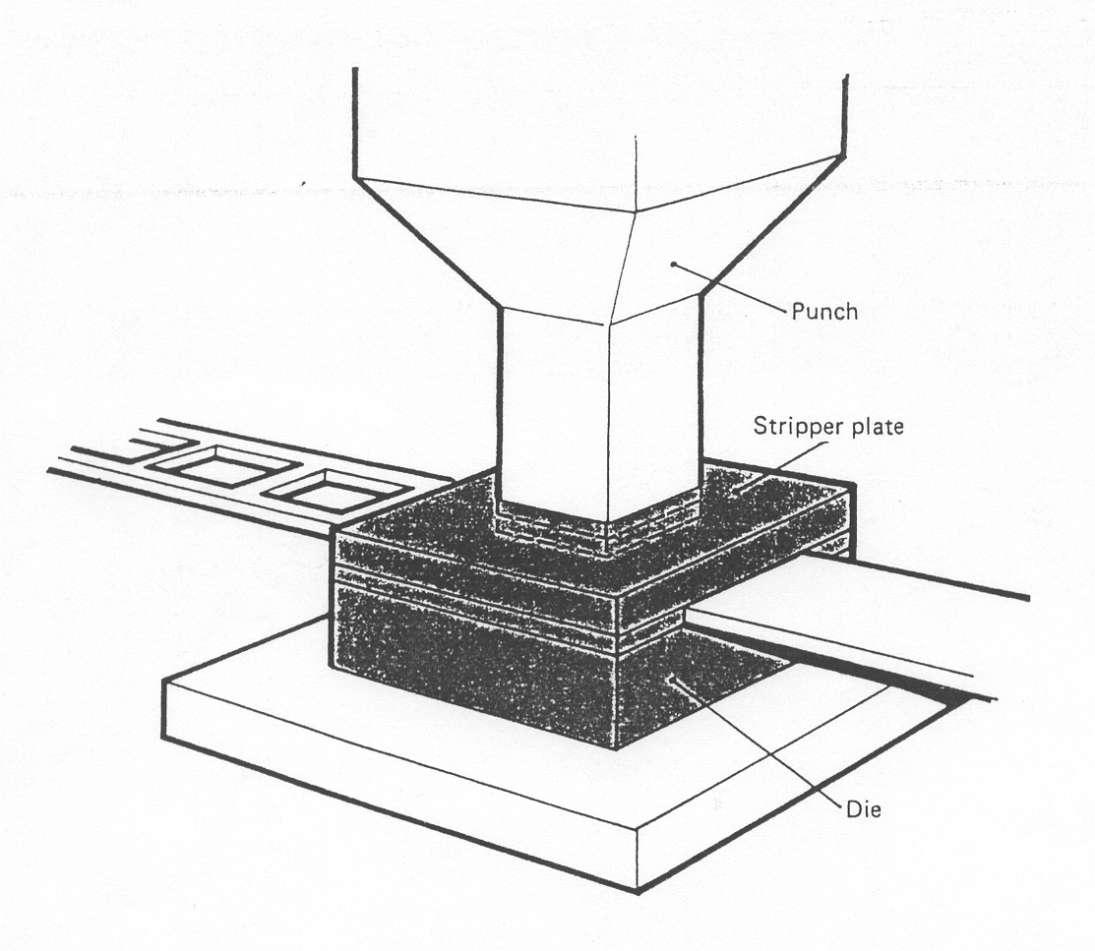
Total enclosure fixed guards

Slide 47
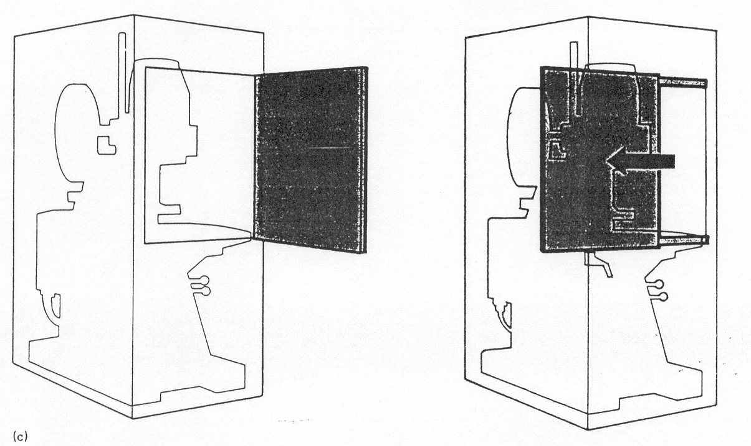
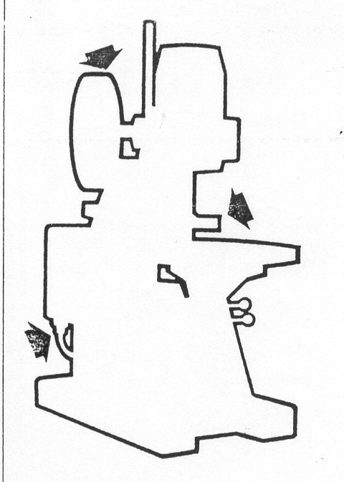
Limited access fixed guards

Slide 48
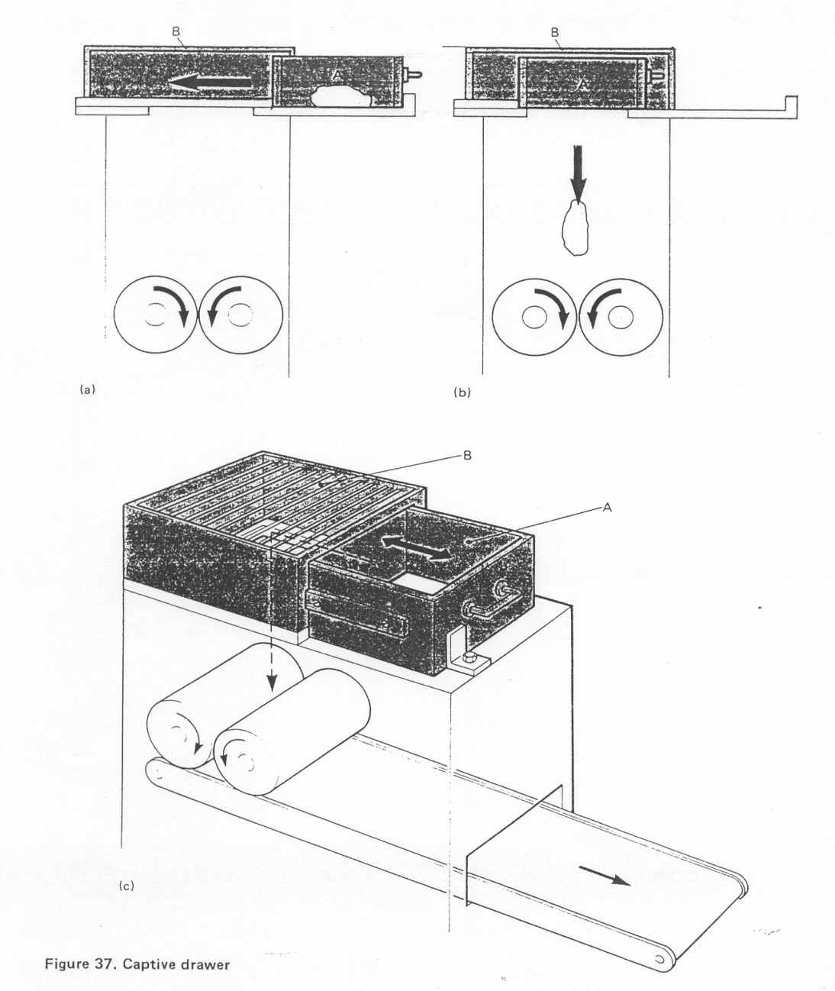
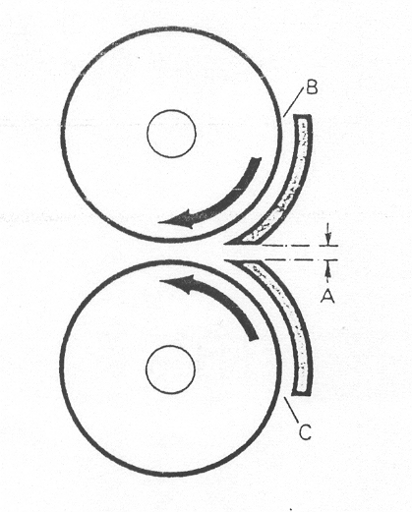
Limited access fixed guards

Slide 49
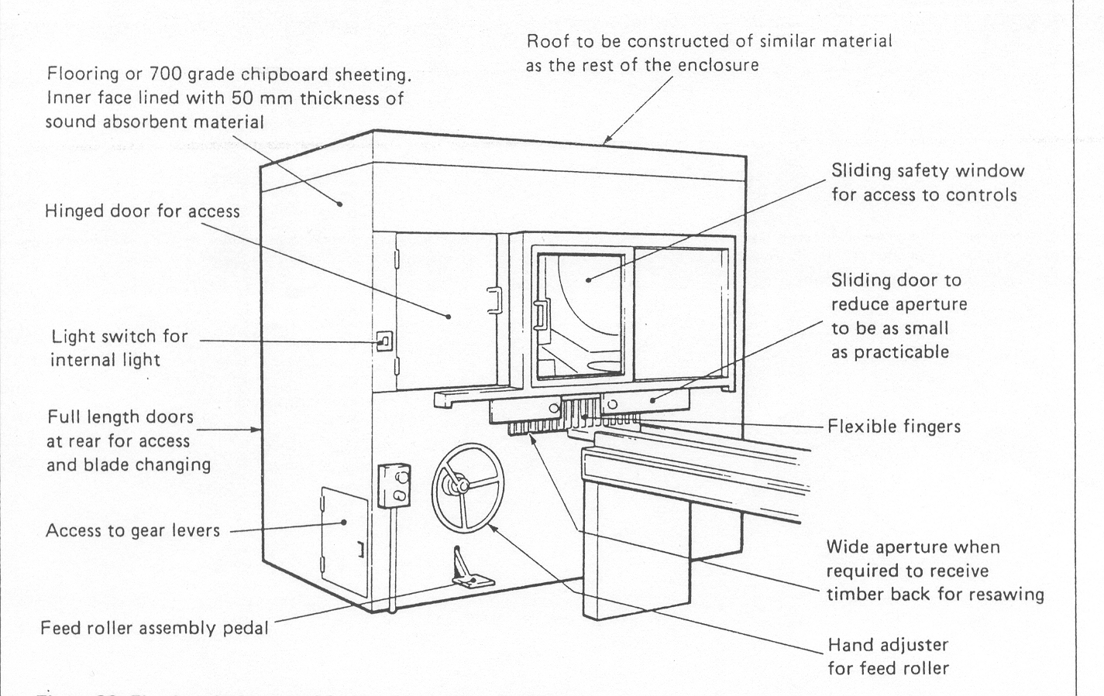
Adjustable access fixed guards

Slide 50
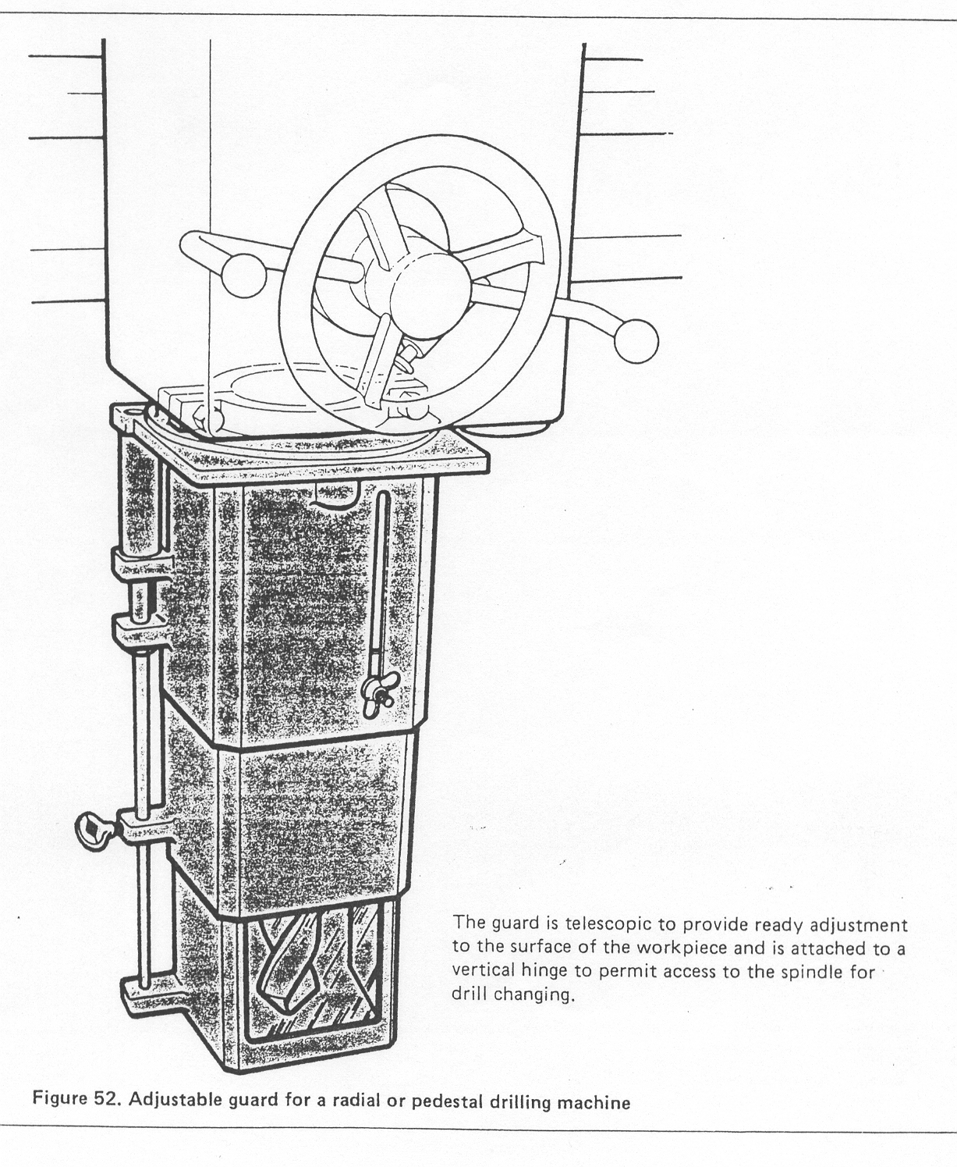
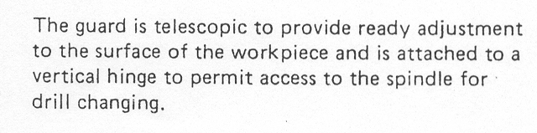
Adjustable access fixed guards

Slide 51
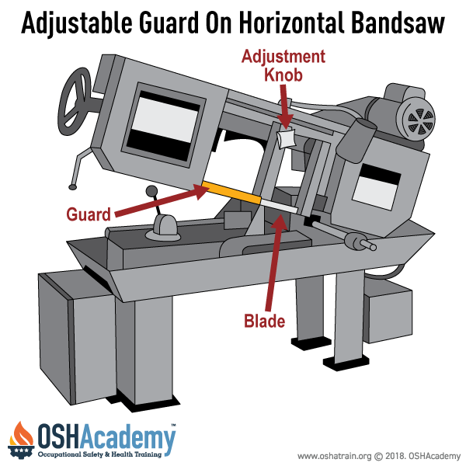

Slide 52
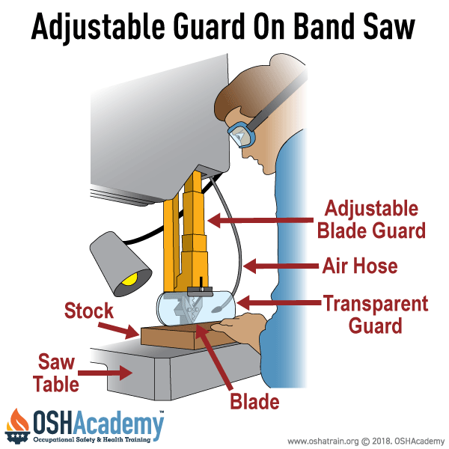

Slide 53
Automatic guards/positional guards 

Slide 54
Beberapa model 
Gates/Fence
Sweep
Mechanical feed
Feed tools
Optical sensors
Ultrasonic
Electric field
Two hands control
Pull-out

Slide 55
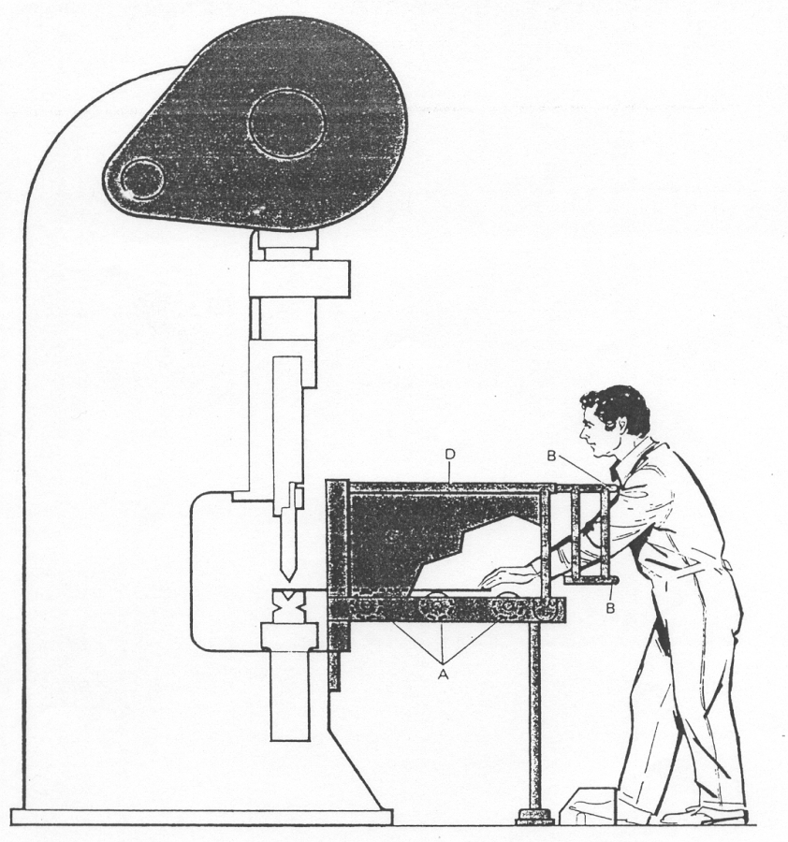
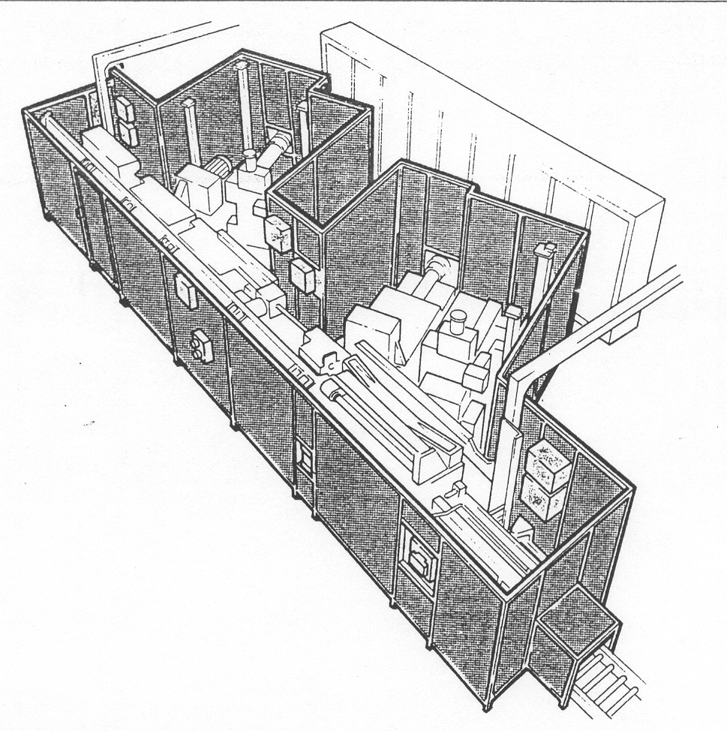
Gates/Fence

Slide 56
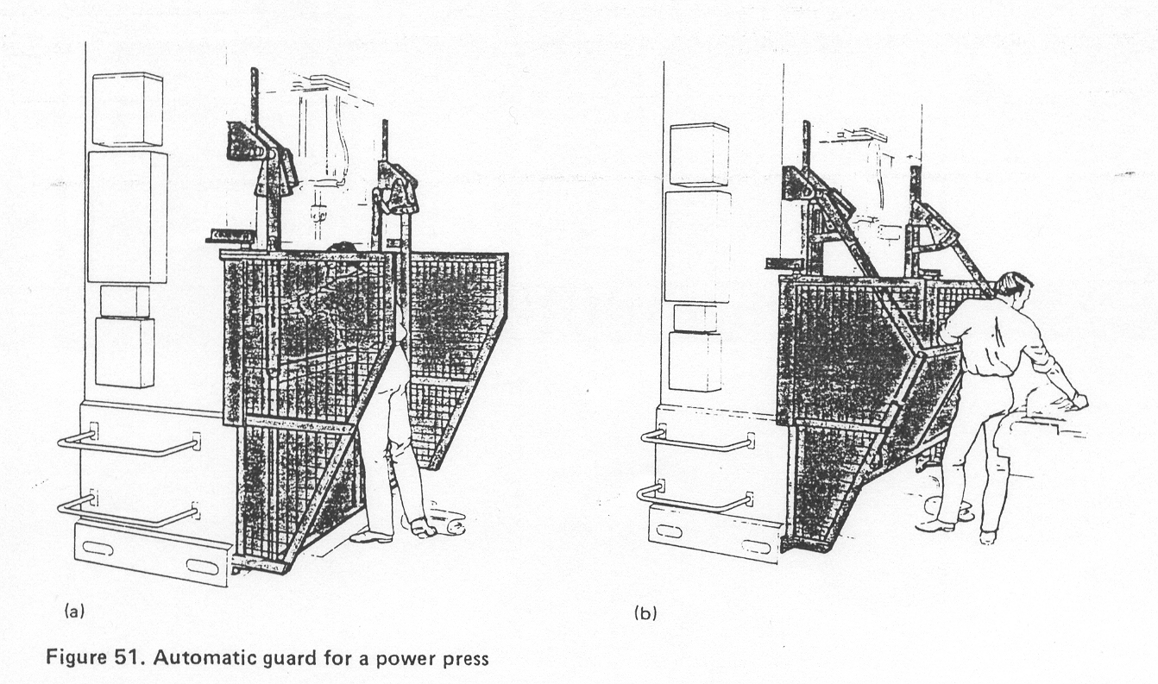
Sweep

Slide 57
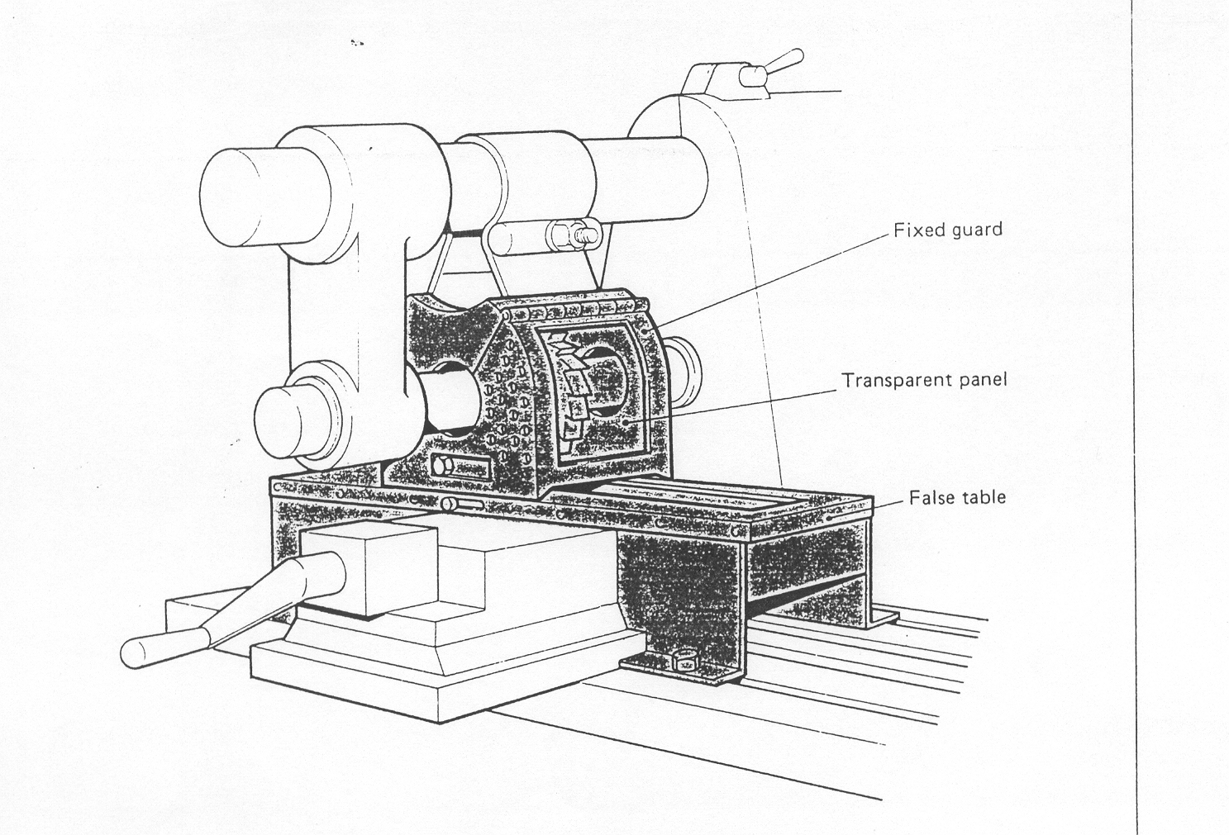
Mechanical feed

Slide 58
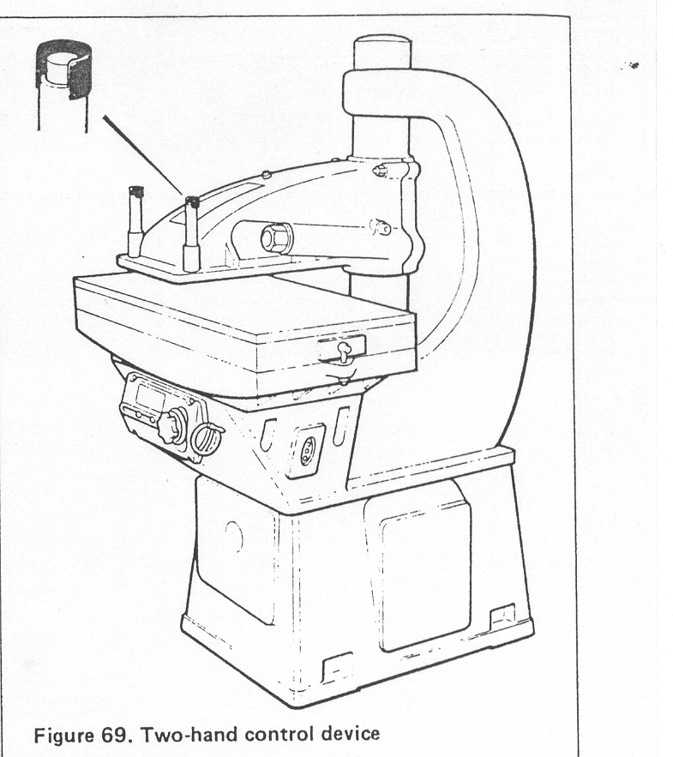
2 hands control

Slide 59
Interlock guards 

Slide 60
2 model rancangan
Control interlock
Scotch interlock

Slide 61
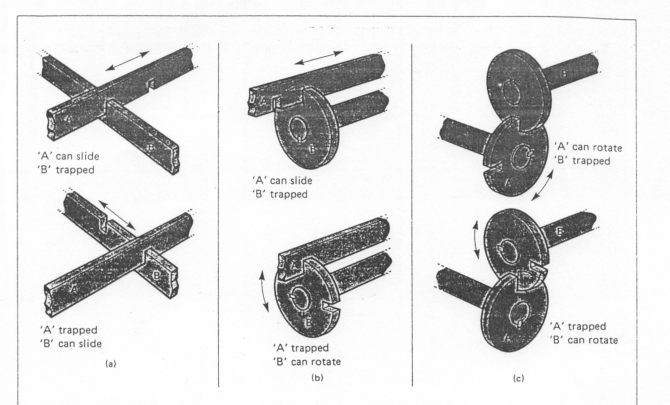
prinsip interlock

Slide 62
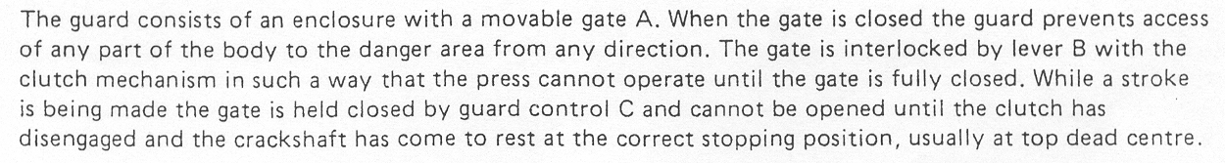
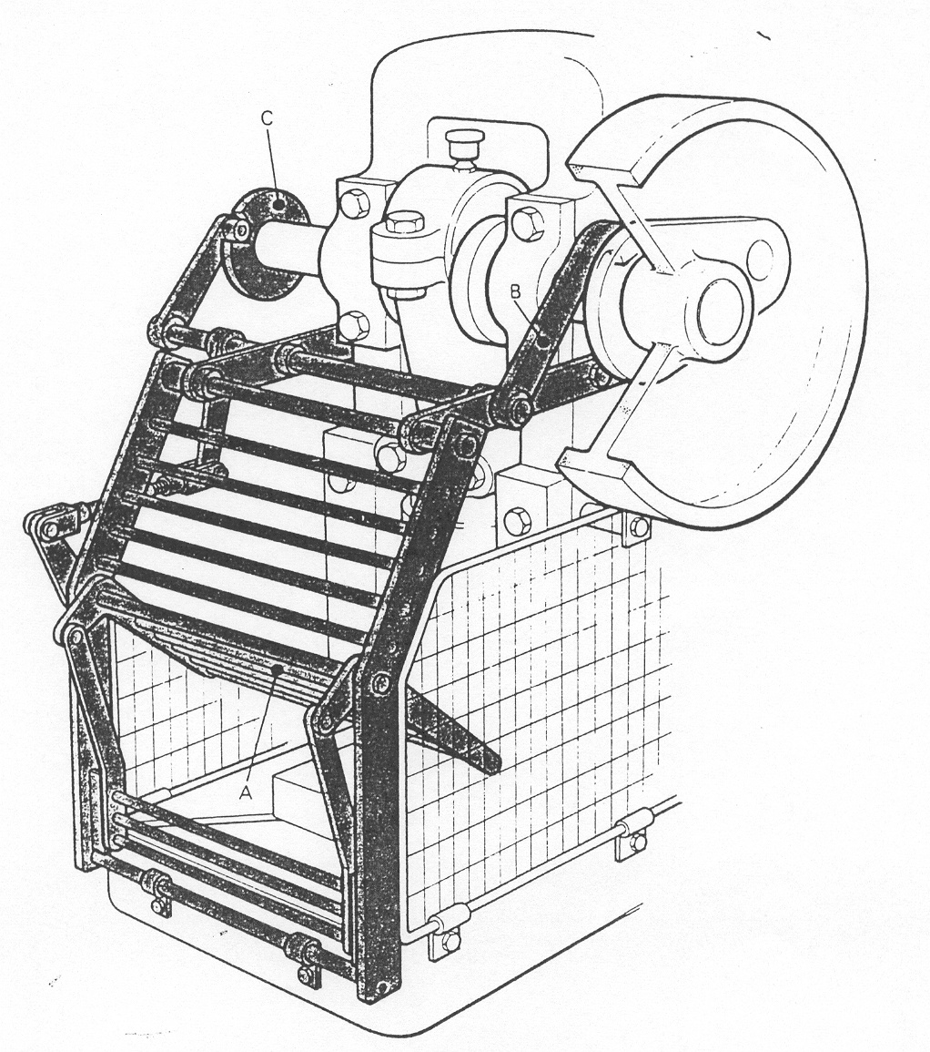
Control interlock

Slide 63
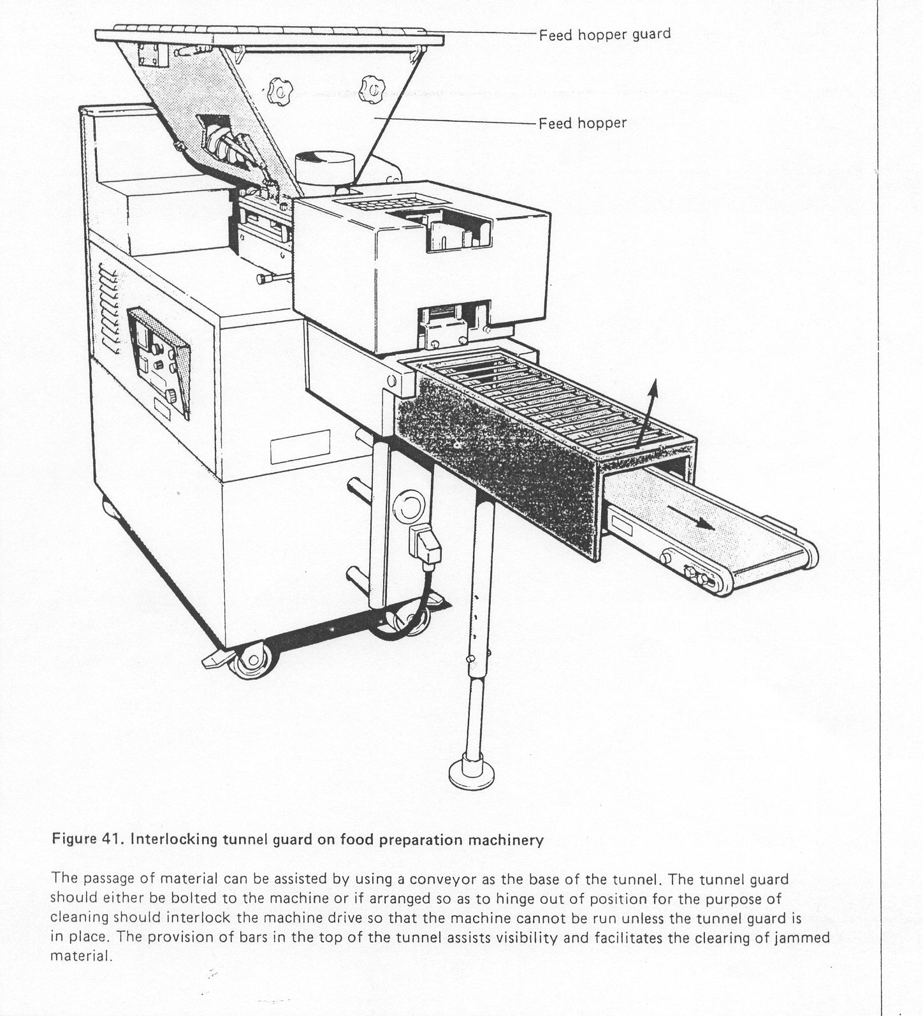
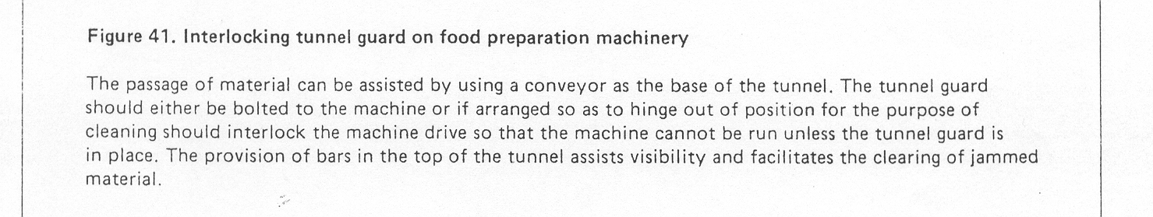
Control interlock

Slide 64
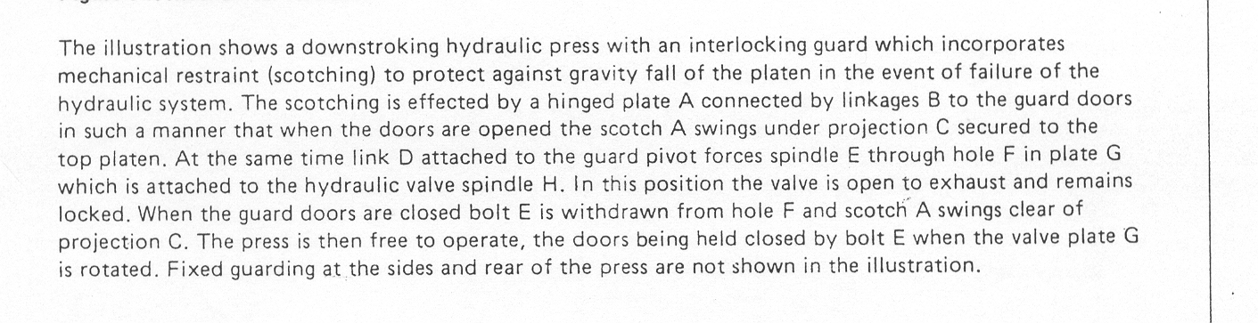
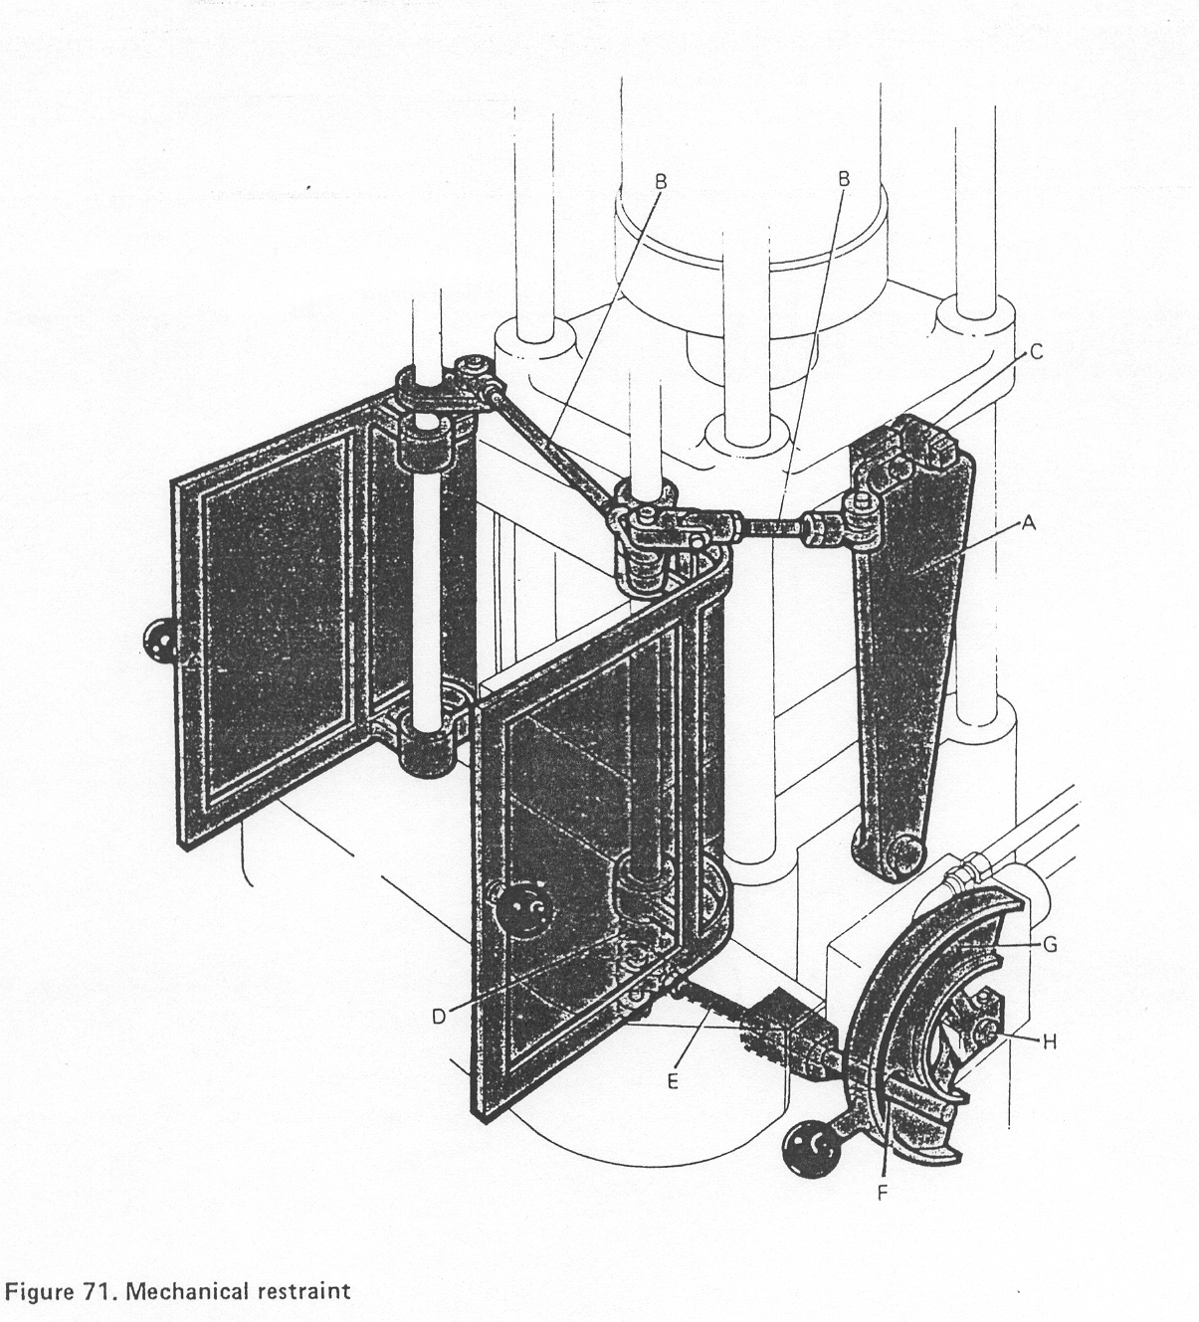
Scotch interlock

Slide 65
Trip guards 

Slide 66
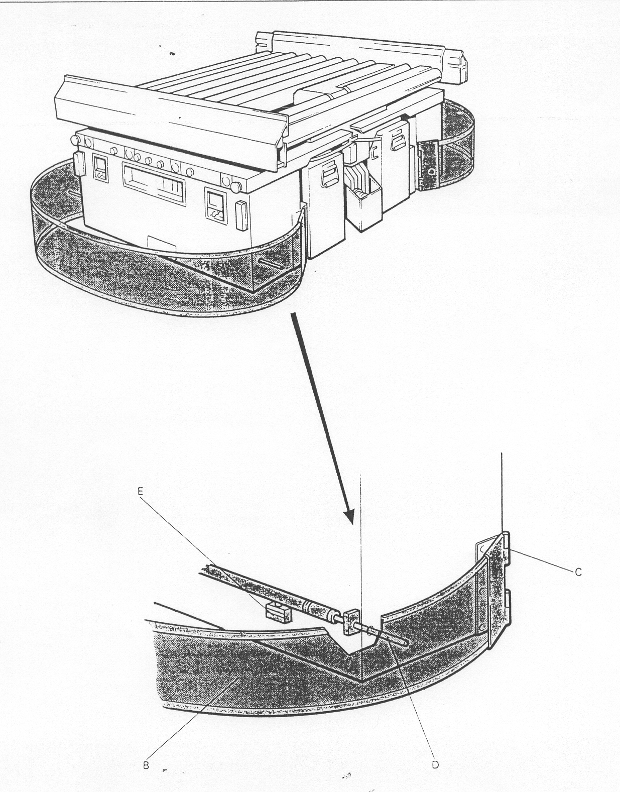
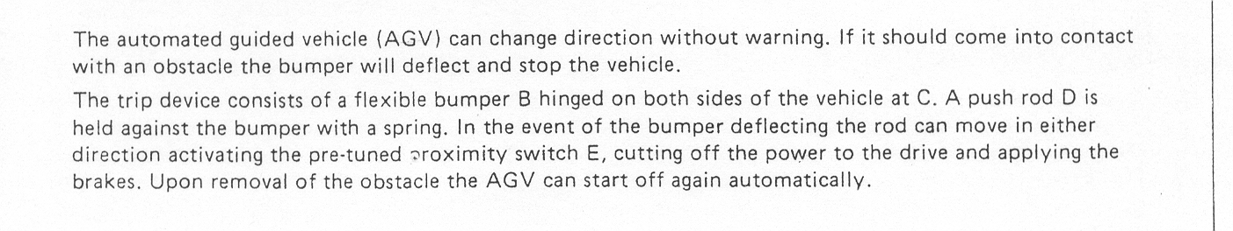
Trip guards

Slide 67
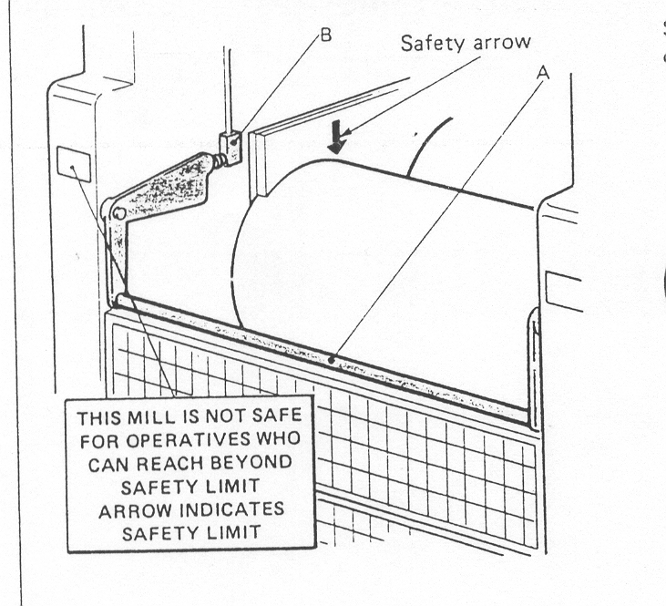
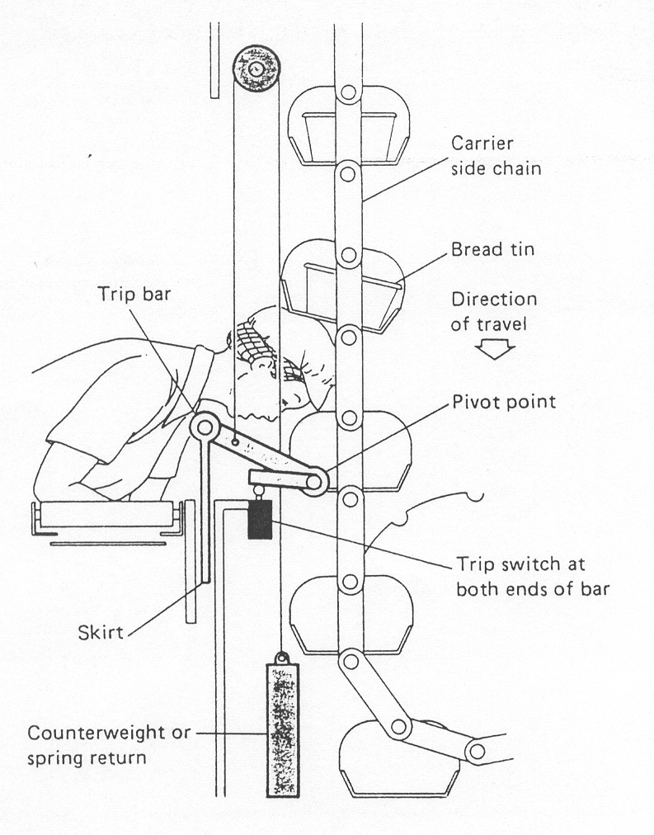
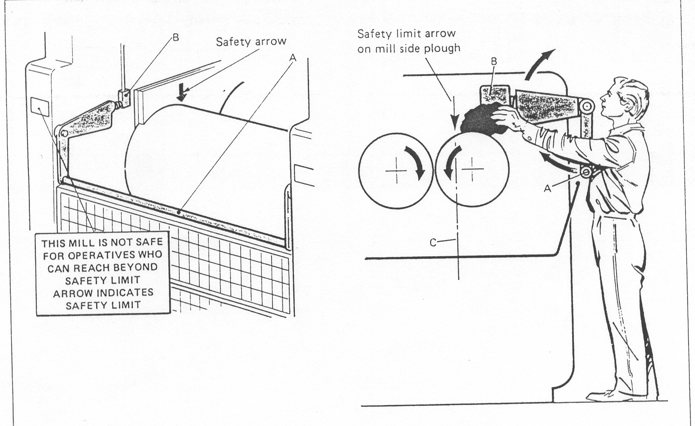
Trip guards

Slide 68
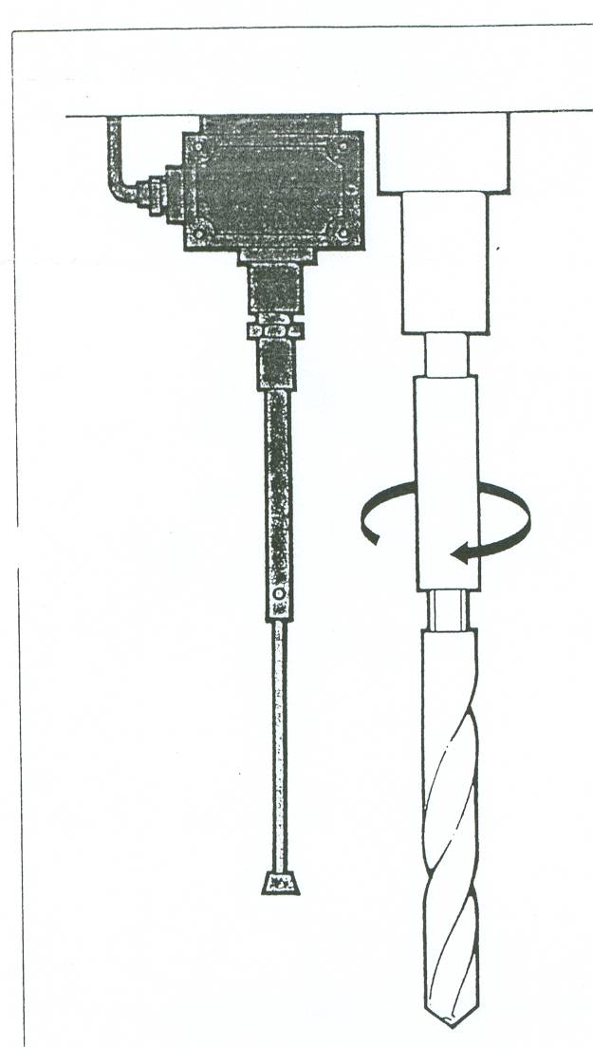
Trip guards

